Slide 1

Loan Application Predictor
Team :
Manan Davey
Meghana Dodda
Shraddha Kamath
Vatsal Rameshbhai Gohel
Venkatesh Dhanuskodi

Slide 2
Contents
Introduction
Objective
Research Questions
Exploratory Data Analysis
Statistical Models
Conclusion: Questions, solutions, inference

Slide 3
Introduction
Includes client’s demographics like gender, marital status, education etc., and the loan details, like loan approval, loan amount, duration, etc.
Data Statistics:
Has 13 variables
19% missing values
Includes categorical, Boolean and numeric values
No duplicates
Client loan data:
Notes:
Increase in loan fraud sand defaults with increasing technology and applications
Need for a solution that can be used by banks to avoid losses
Use of historic data to predict future outcomes

Slide 4
Objective
With the increasing technology and number of loan applications, the related fraud is also rising. To curb this issue, one needs to predict if the loan can be approved based on historic data. Our objective is to:
Build a regression model that determines, depending on the important variables, whether a customer is eligible for a loan or not and the maximum amount that can be offered for rejected applications.
We aim to predict whether an application can be approved or not through a model, build using Machine Learning. This model would help banks with a quick, immediate, and easy way to choose the deserving applicants and the applicants can use this Loan Prediction System to check their own eligibility.

Slide 5
Research Questions
What are the most important factors that determine a customer's loan eligibility?
How to check a person’s eligibility?
For customers who are not eligible for the required loan amount and duration, what is the maximum amount they can borrow for the given duration?

Slide 6
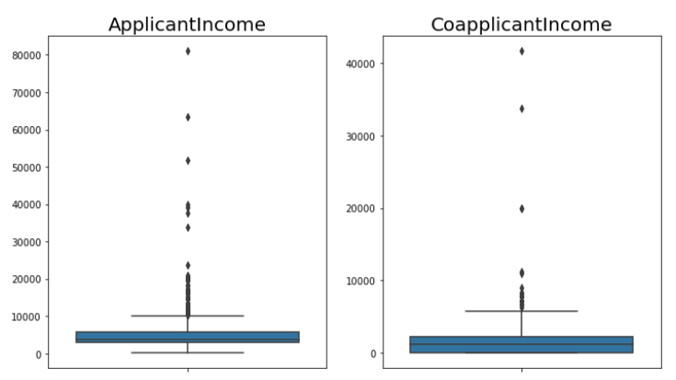
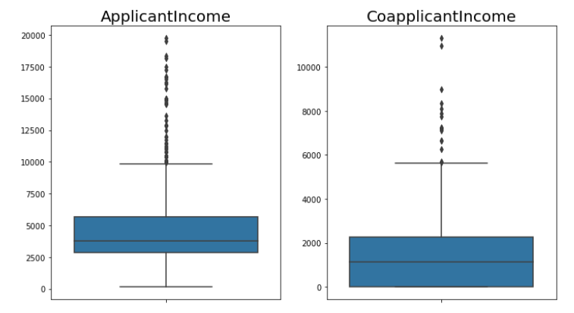
Data Preparation
The entire process is done in a Jupyter notebook using python language and the various libraries it offers
Null values: Imputed with mean or median for numerical values (based on distribution) and mode for categorical ones
Outliers: Treated by limiting with a cap value of 20000 for Applicant income and 12500 for Co-applicant income
Before Outlier Treatment
After Outlier Treatment

Slide 7
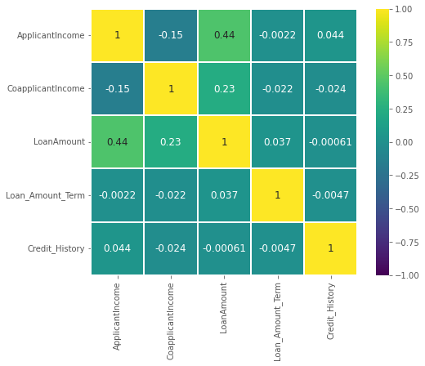
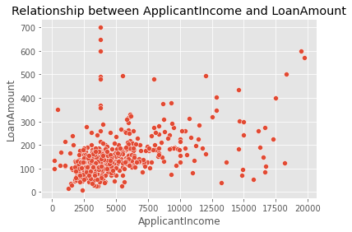
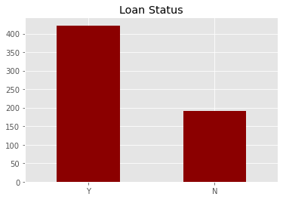
Exploratory Data Analysis
Correlation matrix shows that loan amount and applicant income have the strongest relationship, loan amount and co-applicant income.
The scatter plot between applicant income and loan amount is dense at lower income and loan amount and lighter as the variables increase
There are more loans approved than rejected.

Slide 8
Statistical Models: Logistic Regression and Random Forests
Logistic Regression:
Statistical approach to predict the likelihood of events happening, using the historic data
Based on the relationship between dependent and independent variables
The outcome, i.e., probability of the event happening is between 0 to 1
Random Forests:
A machine learning algorithm that builds multiple decision trees, based on which the outcome is predicted
Can handle missing variables or outliers as well

Slide 9
Research Questions

Slide 10
Important variables determining eligibility
Performed logistic regression to get the coefficients and p-value of all the variables
Calculated the odds ratio for all the variables to determine the strength of the relationship
Variables in the order of importance:
Credit History
Marital Status
Employment (Self-employed/Salaried
Co-applicant Income
Applicant Income
Loan Amount
Dependents
Property Area
Loan Amount Term
Gender
Education
Notes:
Credit History: 31.27660836350969
Marital Status: 1.6897222122328617
Employment (Self-employed/Salaried) : 1.0184819866420558
Co-applicant Income: 1.0000210315721583
Applicant Income: 0.9999840971565046
Loan Amount: 0.9978011064906426
Dependents: 0.9719279281771034
Property Area: 0.9967206933551697
Loan Amount Term: 0.9952942497772078
Gender: 0.7226605918507025
Education: 0.5887124838414842

Slide 11
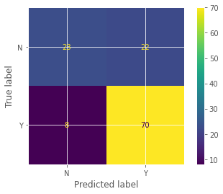
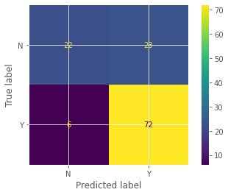
Checking loan eligibility
After data preparation and getting the test and train data sets, Logistic Regression model and Random Forest Classifier are built
For Logistic Regression, the training accuracy is 79.02% and testing accuracy is 75.61% and for Random Forest, training accuracy is 100% and testing accuracy is 81.6%
Based on this, Random Forest is considered the best model to check the loan eligibility
One can provide the model loan application details, and it gives a result as 1 or 0, which can be read as Yes or No respectively.
Please check the appendix for the detailed codes and output
Confusion Matrix: Logistic Regression
Confusion Matrix: Random Forest

Slide 12
Maximum loan amount for non-eligible applicants
A logistic regression model is built to get to the amount that can be approved for rejected applications
Trained the model by replacing positive infinite values with maximum finite value and the negative infinite values with minimum finite value
Model is built such that the revised loan amount for which the application will be approved is obtained.

Slide 13
Conclusion
Three models are built: to identify important factors, check loan eligibility and decide the loan amount for non-eligible applicants
Bank employees can:
enter the applicant’s data for all the important variables identified
run the model to check if the application can be approved or not
quote an amount for rejected applications, using the final model
Customers can:
run their details in the model to see whether they are eligible or not
if rejected, check the amount they would be approved for in the final model
improve their credibility by improving the factors they are lagging in

Slide 14
Thank You!

Slide 15
Appendix

Slide 16
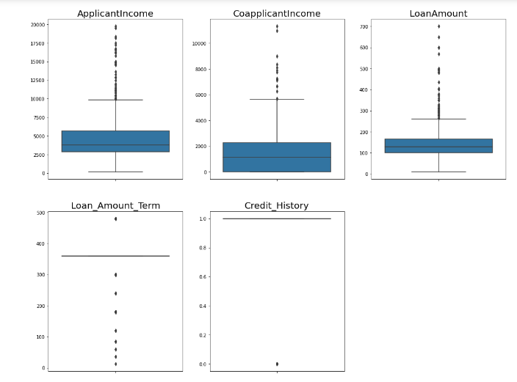
Data Preparation
Box plot of numerical variables, after outlier treatment:

Slide 17
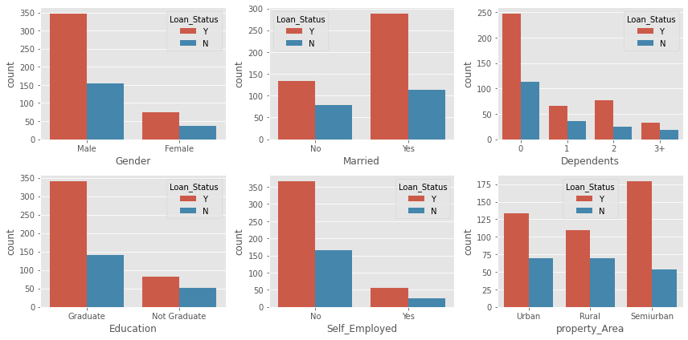
Exploratory Data Analysis
Count plot of categorical variables:

Slide 18
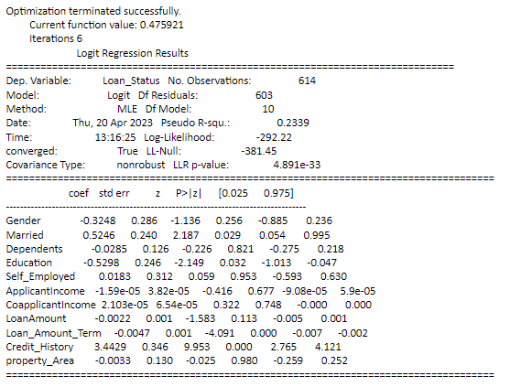
Important variables determining eligibility
Outcome of Logistic Regression model
Code:
import statsmodels.api as sm
from statsmodels.sandbox.regression.predstd import wls_prediction_std
model1=sm.Logit(y,loan_train_v1)
result=model1.fit()
print(result.summary())

Slide 19
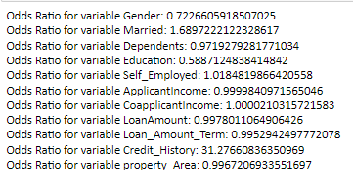
Important variables determining eligibility
Odds ratios for the variables
Code:
coefficients = result.params
# Calculate the odds ratio for each variable
odds_ratio = np.exp(coefficients)
# Print the odds ratio for each variable
for i in range(len(odds_ratio)):
print(f'Odds Ratio for variable {loan_train.columns[i]}: {odds_ratio[i]}')

Slide 20
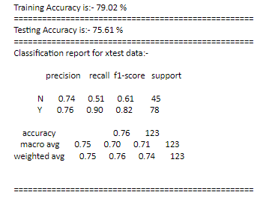
Checking loan eligibility: Logistic regression
Accuracy of Logistic Regression model
Code:
from sklearn.linear_model import LogisticRegression
lr = LogisticRegression(random_state=101)
lr_model = lr.fit(xtrain,ytrain)
tr_pred_lr = lr_model.predict(xtrain)
ts_pred_lr = lr_model.predict(xtest)
from sklearn.metrics import accuracy_score,classification_report,plot_confusion_matrix
tr_acc_lr = round(accuracy_score(ytrain,tr_pred_lr),4)
ts_acc_lr = round(accuracy_score(ytest,ts_pred_lr),4)
print("Training Accuracy is:-",round(tr_acc_lr*100,2),"%")
print("===================================================")
print("Testing Accuracy is:-",round(ts_acc_lr*100,2),"%")
print("===================================================")
print("Classification report for xtest data:-\n\n",classification_report(ytest,ts_pred_lr),"\n")
print("===================================================")
print("Confusin Matrix for xtest data:-\n\n",plot_confusion_matrix(lr_model,xtest,ytest))

Slide 21
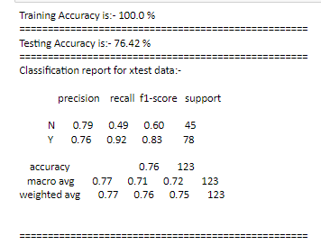
Checking loan eligibility: Random Forests (part 1)
Accuracy of Random Forest model
Code:
from sklearn.ensemble import RandomForestClassifier
rfc = RandomForestClassifier(random_state=101)
rfc_model = rfc.fit(xtrain,ytrain)
tr_pred_rfc = rfc_model.predict(xtrain)
ts_pred_rfc = rfc_model.predict(xtest)
from sklearn.metrics import accuracy_score,classification_report,plot_confusion_matrix
tr_acc_rfc = round(accuracy_score(ytrain,tr_pred_rfc),4)
ts_acc_rfc = round(accuracy_score(ytest,ts_pred_rfc),4)
print("Training Accuracy is:-",round(tr_acc_rfc*100,2),"%")
print("===================================================")
print("Testing Accuracy is:-",round(ts_acc_rfc*100,2),"%")
print("===================================================")
print("Classification report for xtest data:-\n\n",classification_report(ytest,ts_pred_rfc),"\n")
print("===================================================")
print("Confusin Matrix for xtest data:-\n\n",plot_confusion_matrix(rfc_model,xtest,ytest))

Slide 22
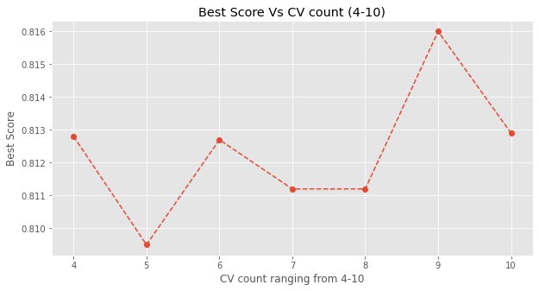
Checking loan eligibility: Random Forests (part 2)
GridSearchCV using random forest model and tuning different cv count
or i in range(4,11,1):
from sklearn.ensemble import RandomForestClassifier
rfc = RandomForestClassifier(random_state=101)
tg = {'max_depth':range(2,10),
'min_samples_split':range(2,5),
'min_samples_leaf':range(2,6)}
from sklearn.model_selection import GridSearchCV
cv = GridSearchCV(rfc,tg,scoring="accuracy",cv=i)
cvmodel = cv.fit(Xnew,Y)
best_score.append(round(cvmodel.best_score_,4))
plt.figure(figsize=(10,5))
plt.plot(range(4,11,1),best_score,"--o")
plt.xticks(range(4,11,1))
plt.xlabel("CV count ranging from 4-10")
plt.ylabel("Best Score")
plt.title("Best Score Vs CV count (4-10)");

Slide 23
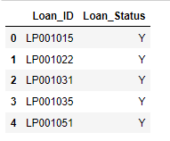
Checking loan eligibility: Random Forests (part 3 )
Code:
Final Grid Search CV Model:
from sklearn.ensemble import RandomForestClassifier
rfc = RandomForestClassifier(random_state=101)
tg = {'max_depth':range(2,10),
'min_samples_split':range(2,5),
'min_samples_leaf':range(2,6)}
from sklearn.model_selection import GridSearchCV
cv = GridSearchCV(rfc,tg,scoring="accuracy",cv=9)
cvmodel = cv.fit(Xnew,Y)
round(cvmodel.best_score_,4)
# Best parameters obtained from GridSearchCV model:
cvmodel.best_params_
Output:
0.816
{'max_depth': 4, 'min_samples_leaf': 2, 'min_samples_split': 2}
Code:
Final Random Forest Classification model using above best parameter grid and passing whole training data:
from sklearn.linear_model import LogisticRegression
# Create logistic regression model with best hyperparameters
lr = LogisticRegression(random_state=101, C=0.1, max_iter=1000)
# Fit the model to the entire training data
lr_model_final = lr.fit(Xnew, Y)
# Make predictions on the test data
loan_status = pd.DataFrame(lr_model_final.predict(Pnew), columns=["Loan_Status"])
submission = test_df_1.join(loan_status)[["Loan_ID","Loan_Status"]]
#submission.to_csv("submission1_w4.csv")

Slide 24
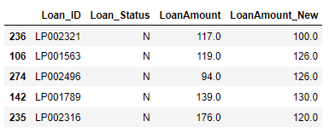
Maximum amount for rejected applicants
Accuracy of Logistic Regression model
Code:
# Replace positive infinity values in Pnew with the maximum finite value in the corresponding column
for col in Pnew.columns:
Pnew[col] = Pnew[col].replace(np.inf, Pnew[col][Pnew[col] != np.inf].max())
# Replace negative infinity values in Pnew with the minimum finite value in the corresponding column
for col in Pnew.columns:
Pnew[col] = Pnew[col].replace(-np.inf, Pnew[col][Pnew[col] != -np.inf].min())
# Make predictions using the trained model
predictions = log_reg_model_final_1.predict(Pnew)
loan_amount_new = pd.DataFrame(log_reg_model.predict(Xnew),columns=["LoanAmount_New"])
final = test_df_2.join(loan_amount_new)[["Loan_ID","Loan_Status","LoanAmount","LoanAmount_New"]]
final.sample(5)

